Slide 1


Version Control

Slide 2
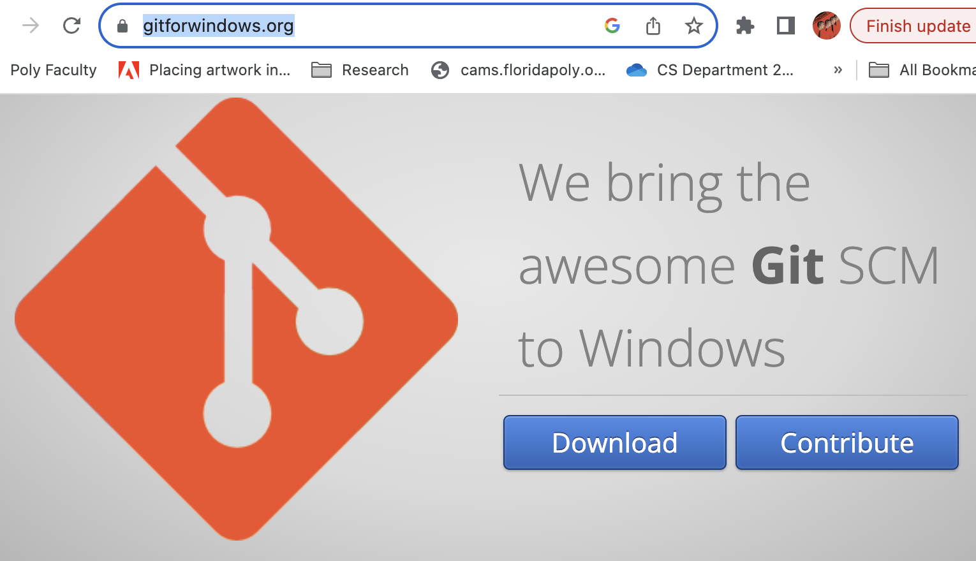
Overview
https://gitforwindows.org/
Version Control Systems
GIT
GitHub
https://www.atlassian.com/agile/tutorials/how-to-do-scrum-with-jira-software

Slide 3
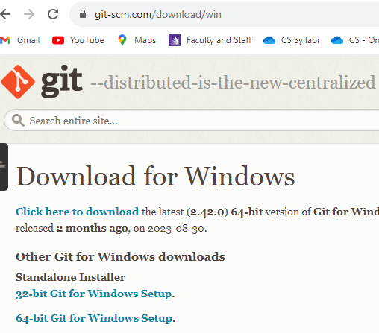
Install Git for Windows

Slide 4

What is Git?
Git is software for tracking changes in a set of files
Allows for branching of software
Git is used for collaboration
PyCharm supports Git from the Windows Subsystem for Linux 2 (WSL2), which is available in Windows 10 version 2004. If Git is not installed on Windows, PyCharm searches for Git in WSL and uses it from there. Also, PyCharm automatically switches to Git from WSL for projects that are opened when you use the \\wsl$ path

Slide 6
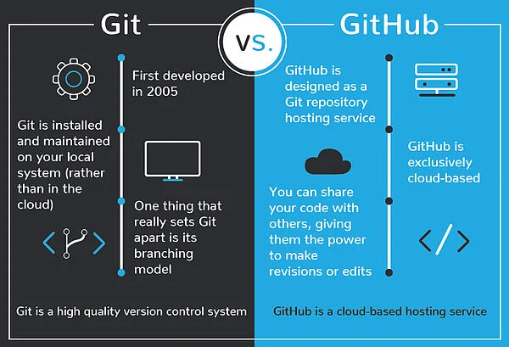
Git is not the same as GitHub
You do not need GitHub to use Git.
You do need Git to use Github desktop.

Slide 7

Steps to start a git repository
Create
Create a directory to contain project
Change
Change directories to the new project directory
Type
Type git init
Create
Create source code (ie Bash, C++, HTML, Python,etc)
Type
Type git add to add the files
Type
Type git commit to update repository with code changes

Slide 8
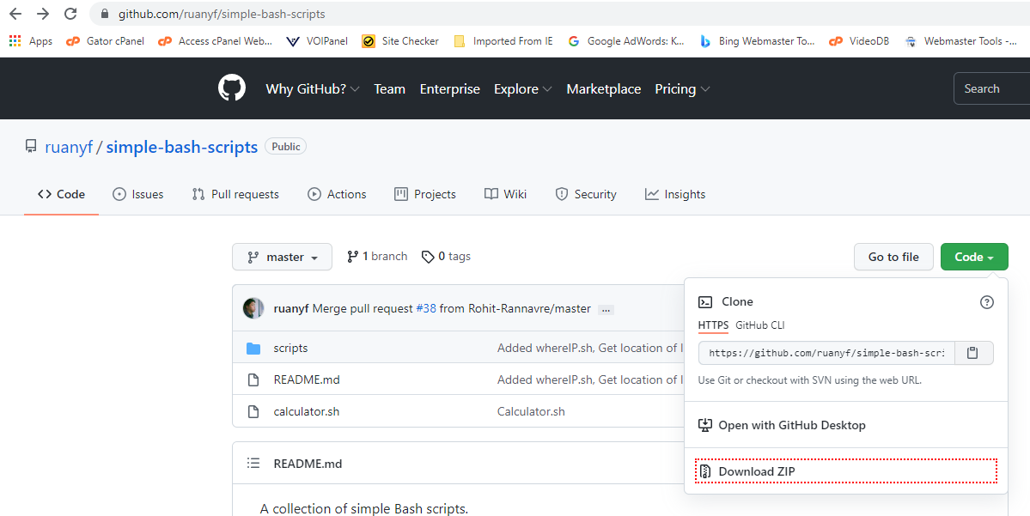
Use github.com as source content to clone a project

Slide 9

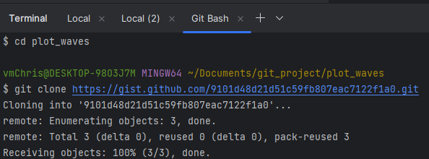
Create a directory then cd to directory
$ git clone https://gist.github.com/9101d48d21d51c59fb807eac7122f1a0.git
ADDRESS is the URL given on the software’s Git page

Slide 10
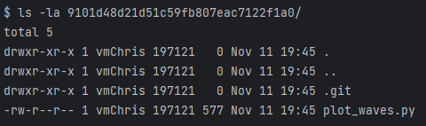
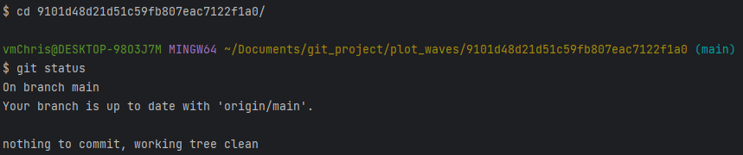
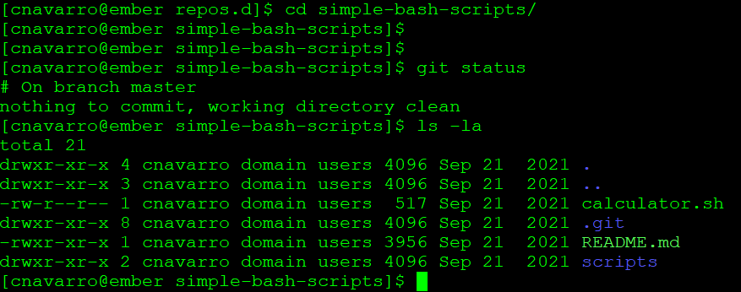
Cd to new cloned directory
List hidden files

Slide 11
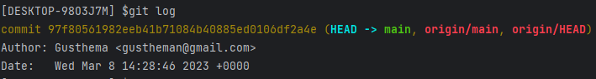
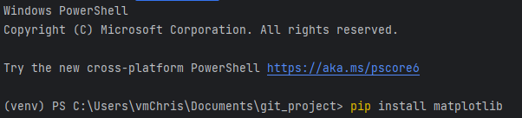
Use git log to check log
pip install matplotlib and numpy from CMD or powershell

Slide 12
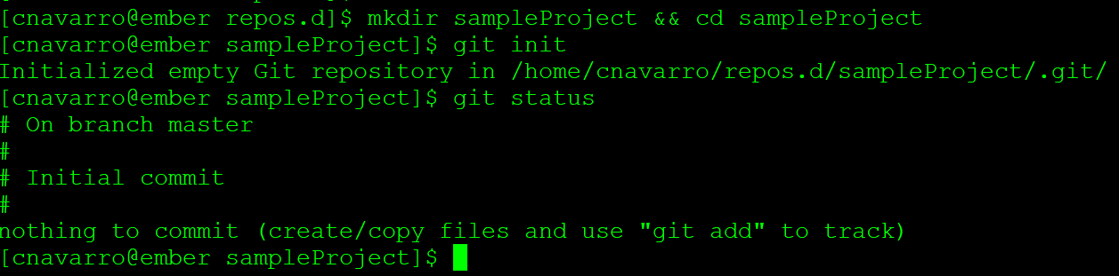
Create your own internal repository
Use git instead of github to create internal repository
Create directory then cd to directory
Initialize directory with init, this turns it into a repository
Check git status

Slide 13
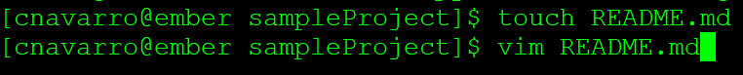
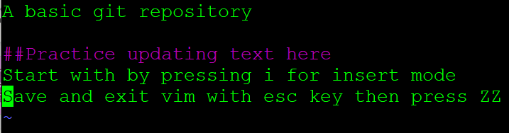
Create content in repository
Create a readme file
Add text to file
If gitbash not responding to esc, use [alt b] then [shift]zz

Slide 14
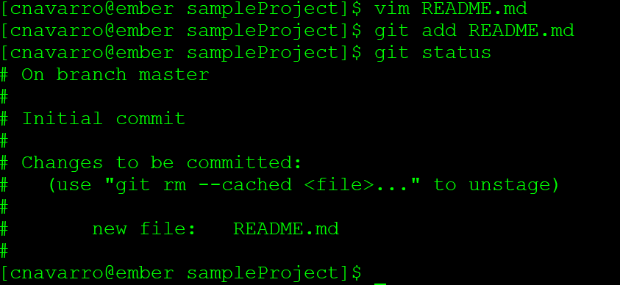
Git is aware of the file but it isn’t in the project until you add with git
This is referred to as staging the file. Not all files need to be staged and tracked for changes
To stage all files in a directory, use $ git add . (this is a period)
To see added files, use git ls-files

Slide 15
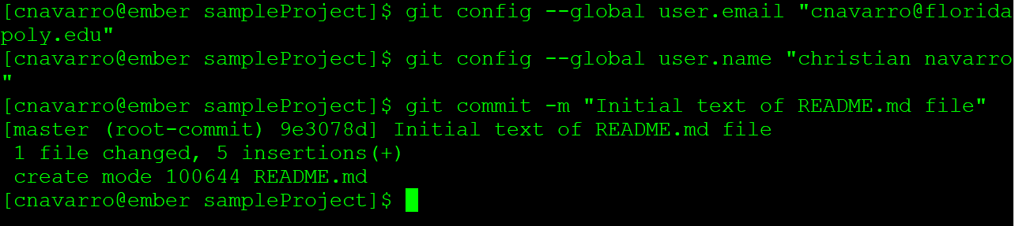
Configure global and make Commit
Configure email and name globally or per repository
This allows for more accurate tracking of version changes
To track updates, run commit with $ git commit –m “text of update”

Slide 16
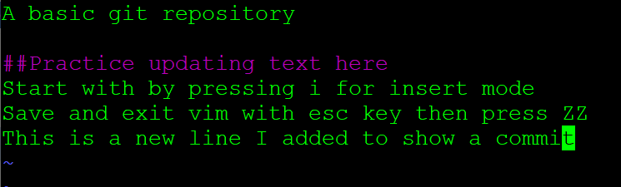
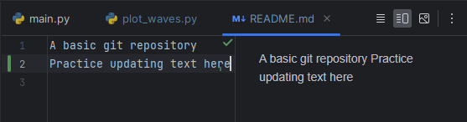
Updating readme file to show tracking after another commit
Press lower case "I" for insert mode. Or just edit the file in Pycharm editor.

Slide 17
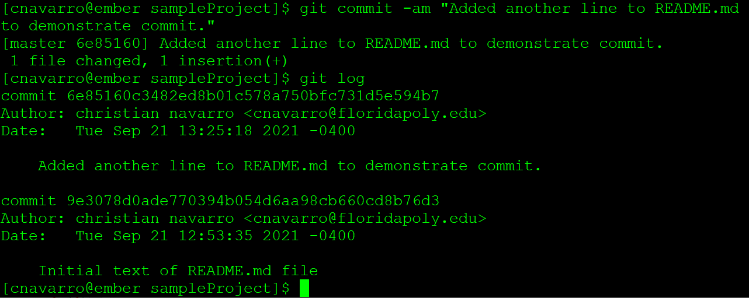
History of commits
Issue commit to track the recent file changes
Use $ git log to view historical commits

Slide 18
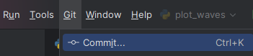
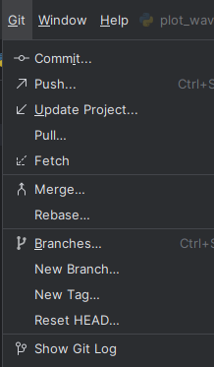
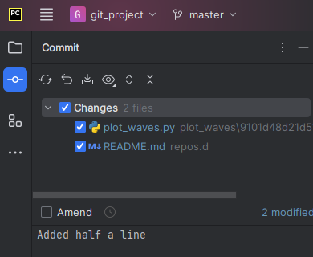


Use git menu (commit) as alternative to CLI

Slide 19

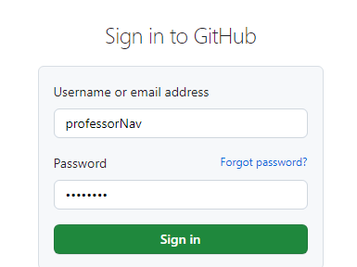
Add repository to github
Git is standalone software that runs on your computer
Use github to have cloud based storage that can be easily shared
Git works with github
To use github, 1st create an account

Slide 20
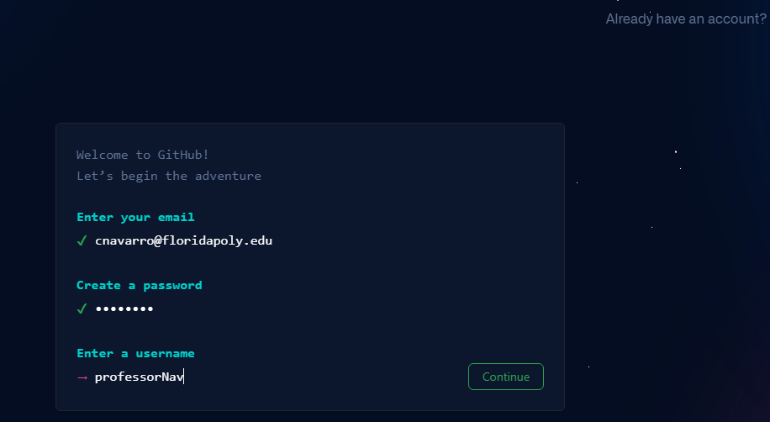
Create a Github account

Slide 21
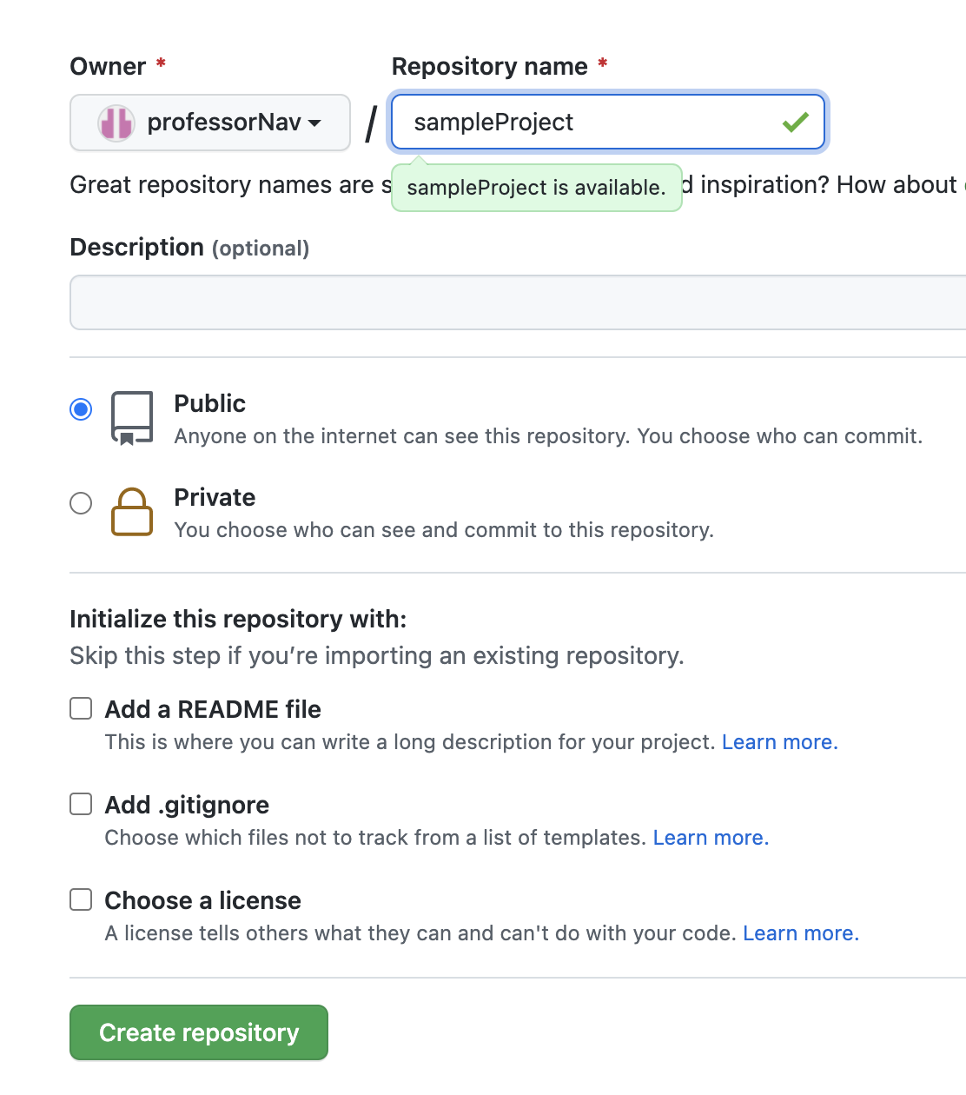
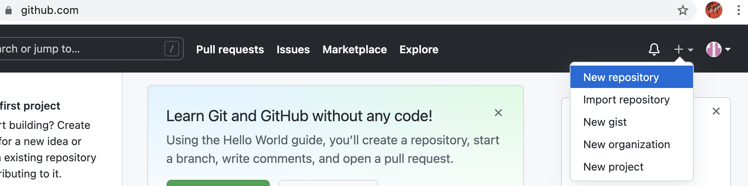
Prepare Github
Add a New repository to your github
Then set up keys (one time) before pushing from local drive to github
Parent directory of files

Slide 22
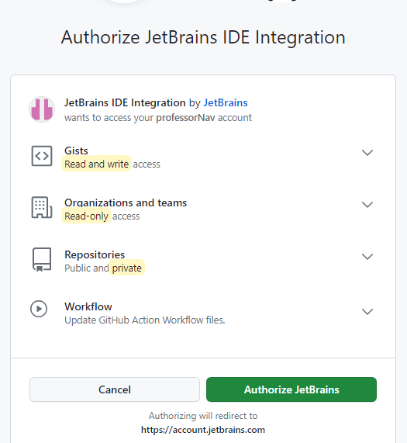
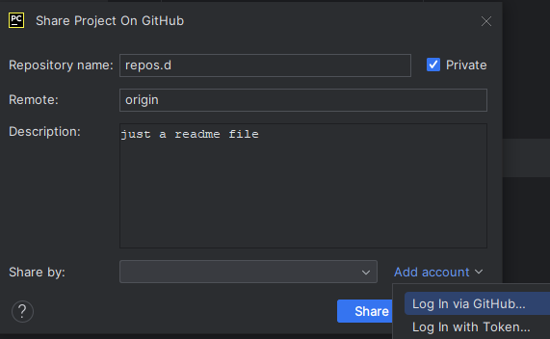
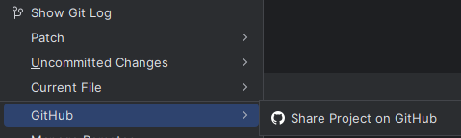
Or use Pycharm Git Menu
Menu Git/Github/Share Project on Github

Slide 23
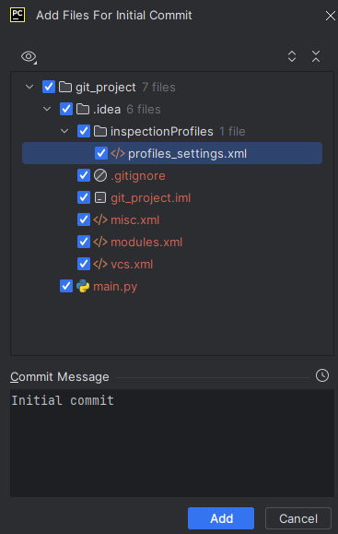


Sharing to Github from Git menu
Press Share
Ok for initial commit

Slide 24
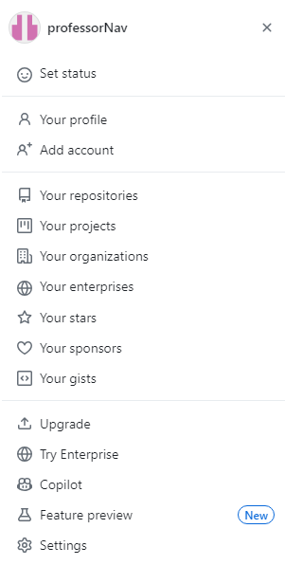


Slide 25
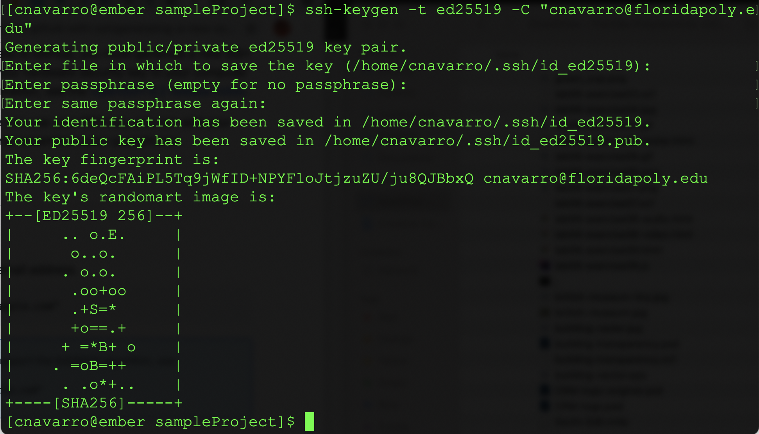
Creating ssh key on local server with public and private keys.
Key will need to be added to the Github account under account/settings/keys

Slide 26
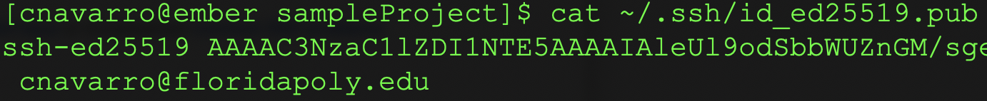
Install local keys
Keys need to be added to allow authentication to github before performing git push

Slide 27
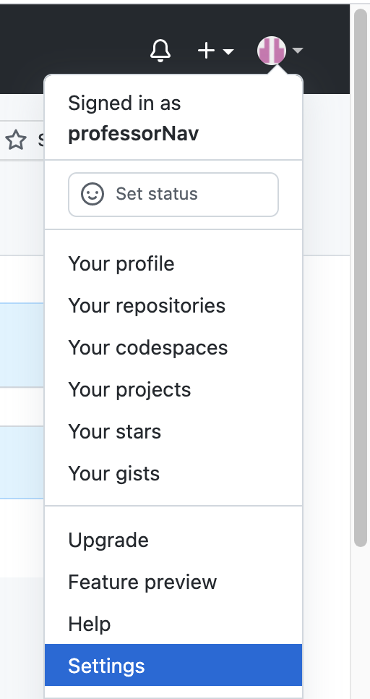
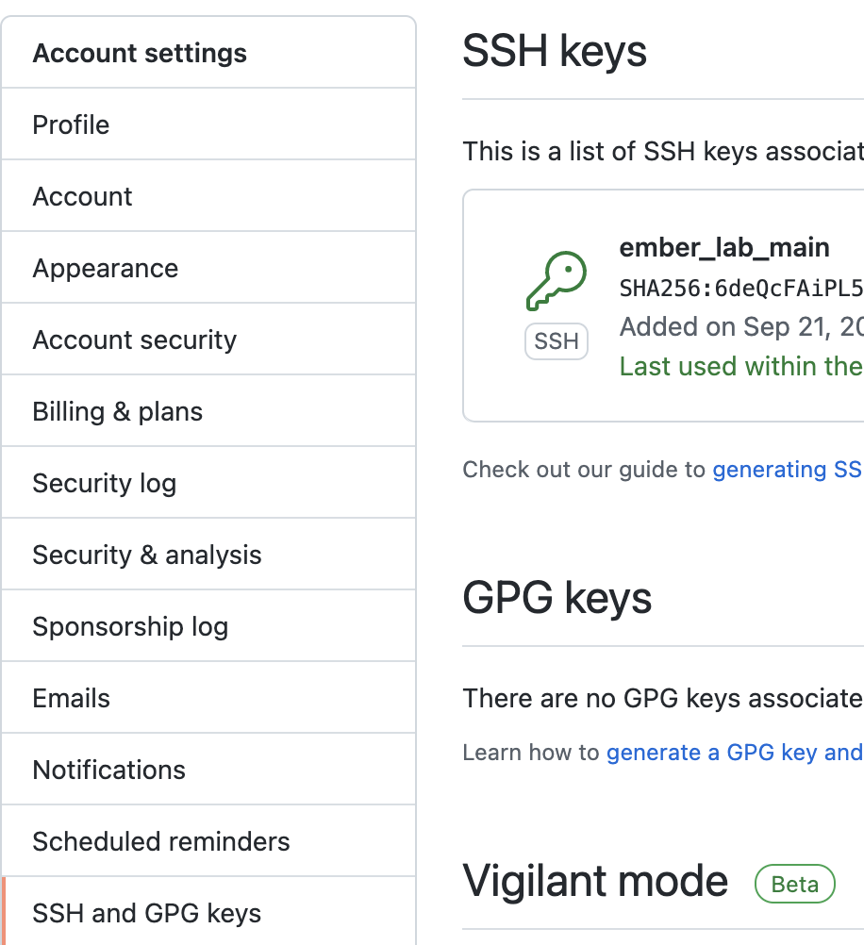
Install public key on github
Cat the public key on server
Copy key to clipboard
Paste to github

Slide 28
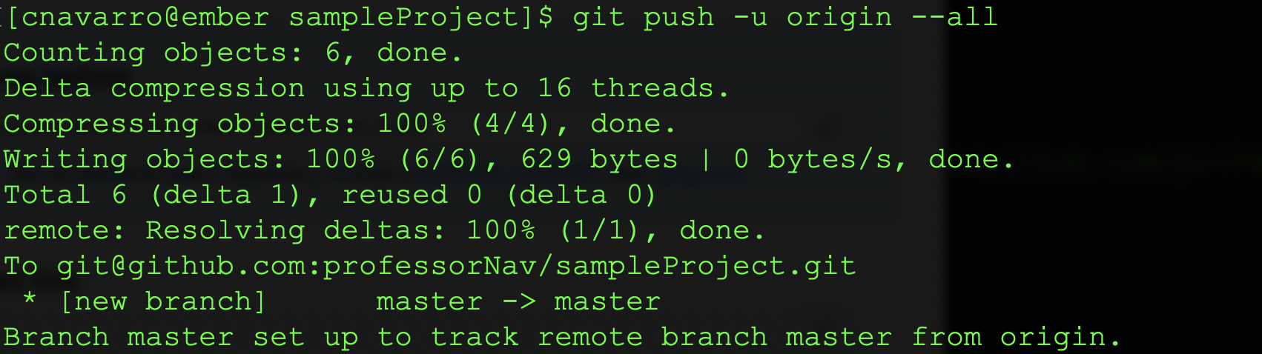
Push repository to github

Slide 29
To reiterate: create a new repository on the command line
echo "# repos.d" >> README.md
git init
git add README.md
git commit -m "first commit"
git branch -M main
git remote add origin https://github.com/professorNav/repos.d.git
git push -u origin main

Slide 30
Or push an existing repo from git Bash
git remote add origin https://github.com/professorNav/repos.d.git
git branch -M main
git push -u origin main

Slide 31
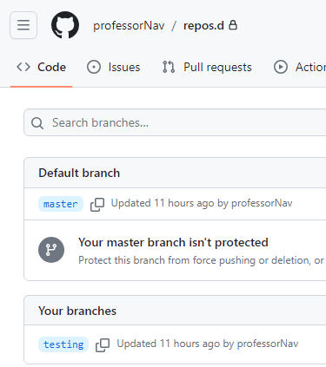
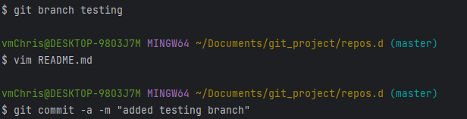
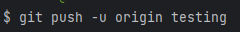
Create new branch
ert

Slide 32
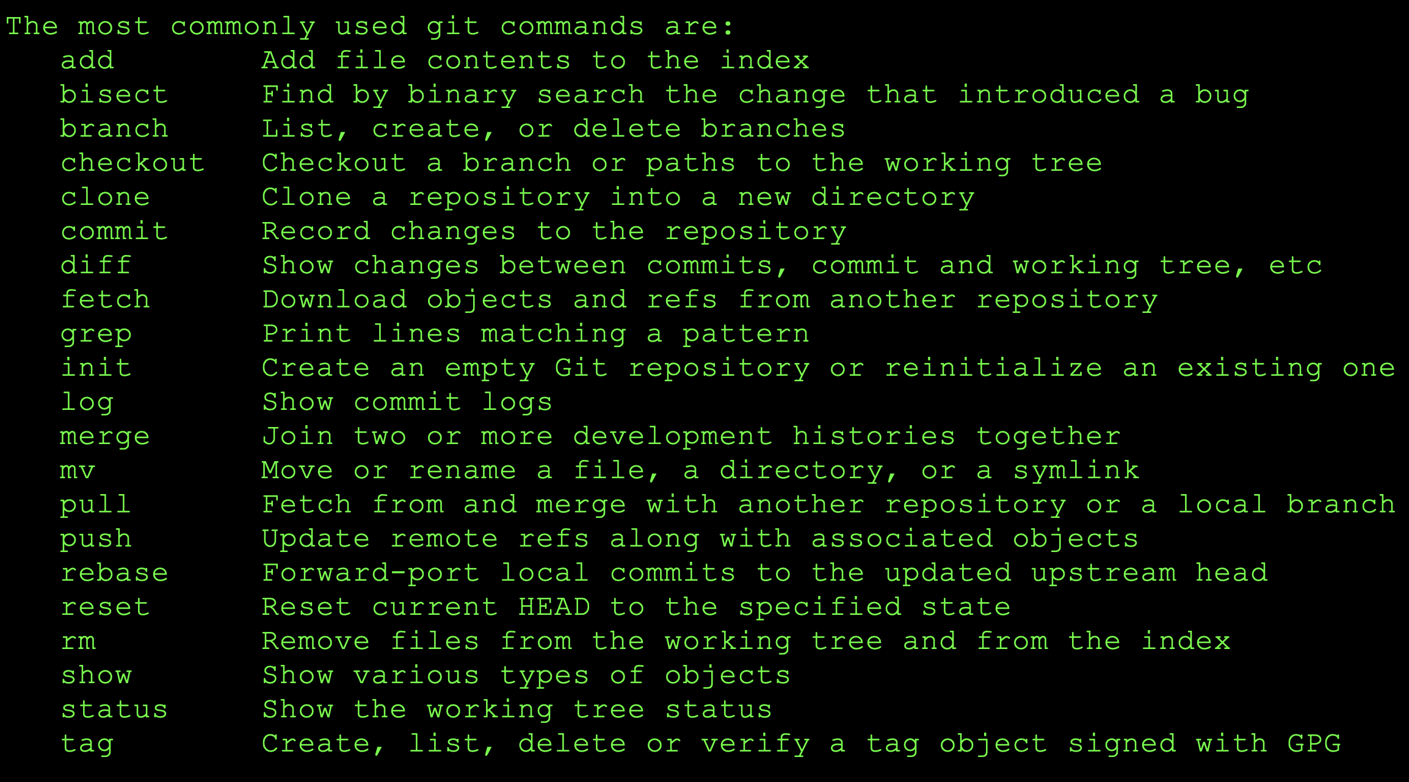
git --help

Slide 33
Beyond git log - more git commands
git clone <repository url>
Download the latest version of a remote project and copying it to the selected location on the local machine
git checkout <branch name>
Checkout command to switch the branch that you are currently working on.
git checkout -b <branch name>
Create a new branch and switch to it
git init <repository name>
Start a new empty repository or to reinitialize an existing one
git branch <new branch>
Create a new branch, without checking it out. Git branch by itself will display current branch.

